Slide 1
Cloud Computing 101
$$$$$$$$$$$$$$$$$$
Notes:
https://aws.amazon.com/getting-started/cloud-essentials/

Slide 2
What is cloud?
Cloud computing is an internet-based computing service in which large groups of remote servers are networked to allow centralized data storage, and online access to computer services or resources.
Using cloud computing, organizations can use shared computing and storage resources rather than building, operating, and improving infrastructure on their own.
Cloud computing is a model that enables the following features.
Users can provision and release resources on-demand.
Resources can be scaled up or down automatically, depending on the load.
Resources are accessible over a network with proper security.
Cloud service providers can enable a pay-as-you-go model, where customers are charged based on the type of resources and per usage.

Slide 3
Cloud service models
IaaS - Infrastructure as a Service
It provides users with the capability to provision processing, storage, and network connectivity on demand. Using this service model, the customers can develop their own applications on these resources.
PaaS - Platform as a Service
The service provider provides various services like databases, queues, workflow engines, e-mails, etc. to their customers. The customer can then use these components for building their own applications. The services, availability of resources and data backup are handled by the service provider that helps the customers to focus more on their application's functionality.
SaaS - Software as a Service
The third-party providers provide end-user applications to their customers with some administrative capability at the application level, such as the ability to create and manage their users. Also some level of customizability is possible such as the customers can use their own corporate logos, colors, etc.
Notes:
SaaS JIRA, Shopify,

Slide 4
Advantages of Cloud Computing
Cost-Efficient − Building our own servers and tools is time-consuming as well as expensive as we need to order, pay for, install, and configure expensive hardware, long before we need it. However, using cloud computing, we only pay for the amount we use and when we use the computing resources. In this manner, cloud computing is cost efficient.
Reliability − A cloud computing platform provides much more managed, reliable and consistent service than an in-house IT infrastructure. It guarantees 24x7 and 365 days of service. If any of the server fails, then hosted applications and services can easily be transited to any of the available servers.
Unlimited Storage − Cloud computing provides almost unlimited storage capacity, i.e., we need not worry about running out of storage space or increasing our current storage space availability. We can access as much or as little as we need.
Backup & Recovery − Storing data in the cloud, backing it up and restoring the same is relatively easier than storing it on a physical device. The cloud service providers also have enough technology to recover our data, so there is the convenience of recovering our data anytime.
Easy Access to Information − Once you register yourself in cloud, you can access your account from anywhere in the world provided there is internet connection at that point. There are various storage and security facilities that vary with the account type chosen.

Slide 5
Infrastructure as Code (IAC)
Similar to the way software developers write application code, AWS provides services that enable the creation, deployment, and maintenance of infrastructure in a programmatic, descriptive, and declarative way.

Slide 6
Container
Containers provide a standard way to package your application's code, configurations, and dependencies into a single object. Containers share an operating system installed on the server and run as resource-isolated processes, ensuring quick, reliable, and consistent deployments, regardless of environment.
Docker is a software platform that allows you to build, test, and deploy applications quickly. Docker packages software into standardized units called containers that have everything the software needs to run including libraries, system tools, code, and runtime. Using Docker, you can quickly deploy and scale applications into any environment and know your code will run.
Notes:
https://www.docker.com/resources/what-container/

Slide 7
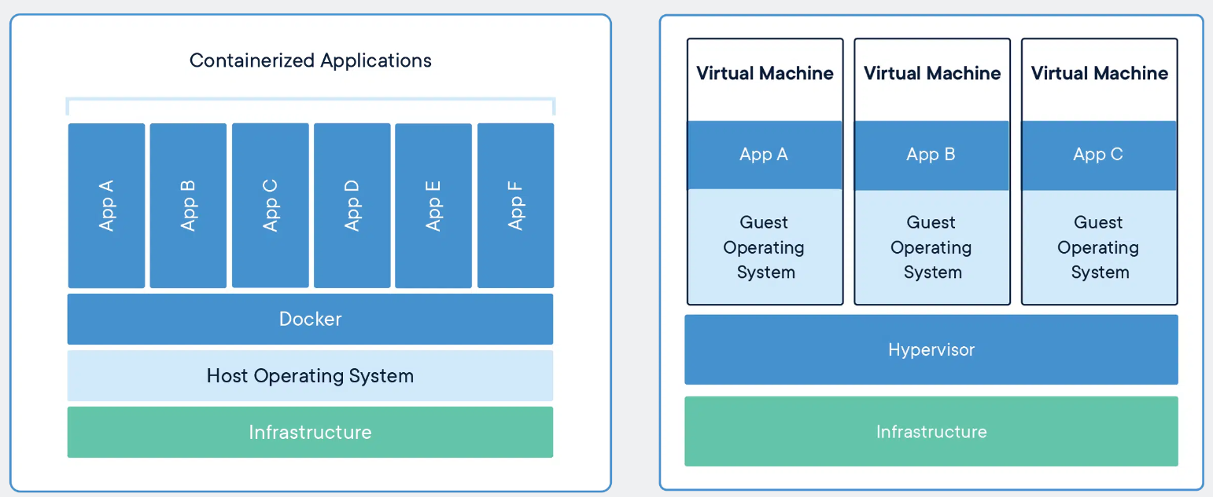

Slide 8
Kubernetes
Kubernetes is open-source software that allows you to deploy and manage containerized applications at scale. Kubernetes manages clusters of compute instances and runs containers on those instances with processes for deployment, maintenance, and scaling. Using Kubernetes, you can run any type of containerized applications using the same toolset on-premises and in the cloud.

